Slide 1

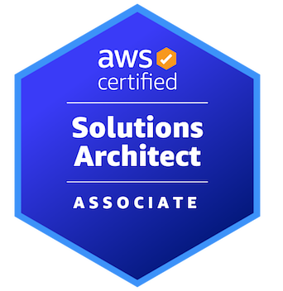

AWS CERTIFIED SOLUTIONS ARCHITECT - ASSOCIATE
Data Migration and Transfer
AMBER ISRAELSEN
Developer | Technical Trainer
Notes:
m9-01 = “Module Introduction”
Hi friends, and welcome back! I’m Amber Israelsen, and this is the AWS Certified Solutions Architect Associate course.

Slide 2
Course Outline (Part 1)
Course Introduction
AWS Cloud Practitioner Refresher
Authentication and Authorization – Identity and Access Management (IAM)
Compute
Elastic Load Balancing and Auto Scaling
Networking
Storage
Databases
Data Migration and Transfer
Analytics
Notes:
We’re moving right along in the course. Now that we’ve covered things like storage and databases—how to house and query our data—let’s talk about how to get data into AWS. This module is all about data migration and transfer.
We’ll cover things like the Database Migration Service, DataSync, Transfer Family and a lot more. Let’s get started.

Slide 3



Database Migration Service (DMS)
Source Database
EC2 Instance with DMS
Target Database
Notes:
m9-02 = “AWS Database Migration Service (DMS) Overview”
Let’s start with the Database Migration Service, or DMS. The way this works is you have your (click) source database, and that can be either on-premises or it can be in AWS. Then you’ll have (click) an EC2 instance with DMS, and it uses what are called replication tasks. And (click) then a target database. And it’s probably more common for this to be in AWS, but you can also migrate things to an on-premises database as well. So you could go on-prem to AWS or on-prem to on-prem or AWS to on-prem or AWS to AWS. So all the combinations!
Let’s look at a couple examples.

Slide 4
Database Migration Service (DMS) Example
Source Database
EC2 Instance with DMS
Target Database
Oracle database that lives on-premises
Amazon RDS for Oracle database
Notes:
You could have something like an Oracle database that lives on-premises, and you want to migrate it to an Oracle database in AWS, which because Oracle is a relational database, you’d use the Relational Database Service, or RDS.
So here you’re using the same database engine—Oracle—on both sides.

Slide 5
Database Migration Service (DMS) Example
Source Database
EC2 Instance with DMS
Target Database
MySQL Database that lives in Amazon RDS
Aurora Database
Notes:
But you can also have a heterogeneous setup where the source and target are using different database engines. So maybe a MySQL database that lives in RDS, and you want to go to an Aurora database. Those are two different engines. That’s fully supported.

Slide 6
Schema Conversion Tool
Used to translate your database schema when your source and target databases are using different engines (e.g., PostgreSQL to Oracle)
You can also pre-create the schema on the target
Notes:
BUT when you have two different engines, they’re also going to have different schemas.
In that situation, you’ll want to use something called the Schema Conversion Tool. This will basically translate your database schema so that things will work in the target database. For example, going from a PostgreSQL engine to an Oracle engine.
But you CAN also pre-create the schema on the target if you’d like. But for exam purposes, if you have a question about databases that use two different engines, you’ll want to think Schema Conversion Tool.

Slide 7
Sources and Targets for Databases
Sources
Targets
Oracle
Microsoft SQL Server
Microsoft Azure SQL
Google Cloud for MySQL
PostgreSQL
SAP ASE
DocumentDB
S3
IBM Db2
Oracle
Microsoft SQL Server
MySQL
MariaDB
PostgreSQL
SAP
Redis
Aurora, Redshift, S3, DynamoDB, OpenSearch, ElastiCache, Kinesis Data Streams, DocumentDB, Neptune, Kafka
Notes:
And then here’s a list of the types of database engines that are supported on both sides. You aren’t going to need to know all of these, but in general, all of the popular engines will be supported, and even S3, which isn’t technically a database. On the target side, obviously you’ll have lots of the AWS services supported, as you’ll see there on the bottom.

Slide 8

AWS DataSync
Used to move large amounts of data
From on-premises to AWS
From AWS to AWS
From other clouds to AWS
Notes:
m9-03 = “AWS DataSync Overview”
Next up, let’s talk about AWS DataSync, which is used to move large amounts of data. And this could be from on-premises to AWS, from AWS to AWS—maybe from the Elastic File System to S3, for example—or from other clouds to AWS, such as Google Cloud Platform or Azure, for example.

Slide 9




On-Premises to AWS Example
On-Premises
Region
S3
EFS
FSx
NFS
SMB
S3 API
HDFS
Encrypted transfer
(scheduled)
DataSync Agent
Shared File System or Object Storage
Notes:
Let’s walk through an example of how it would work going from on-premises to AWS.
On-premises (click), you have either a file system or object storage. And then you’re (click) going to have a DataSync agent. This is essentially (click) a virtual machine that connects to the on-premises storage. And then (click) on a schedule—this isn’t a continuous thing—data will be securely transferred to AWS (click), and then the DataSync service there will copy the data to the various other services. It could be S3, EFS or FSx.
So that’s DataSync in a nutshell. For the exam, know that it’s used to transfer large amounts of data either from on-premises to AWS, within AWS, or from another cloud provider to AWS.

Slide 10


Lift-and-Shift Migrations
On-Premises
Notes:
m9-04 = “AWS Application Migration Service Overview”
Now let’s talk about lift-and-shift migrations, and the services available to help with that.
If you’re not familiar with the term lift-and-shift, it’s something like this. You have (click) various databases and servers and applications and code on-premises, and you need to move them to AWS.

Slide 11

Lift-and-Shift Migrations
On-Premises
Re-architecting
Re-developing
Consolidating
Notes:
Well, the approach that a lot of companies take is to re-architect and re-develop their applications, maybe even consolidate and do some spring cleaning of technical debt and legacy applications other things that have built up over the years on-premises. Maybe you break architectures into microservices instead of monoliths, or maybe you transition from a SQL Server database to a NoSQL database so that you can take advantage of AWS technologies like DynamoDB, for example.
This kind of work, though extremely valuable to do before moving to the cloud—so you can really take advantage of its power—it’s also extremely time-consuming for most companies.

Slide 12
Lift-and-Shift Migrations
On-Premises
Notes:
And the idea of a lift-and-shift is to not change your applications or databases at all. You just take exactly what you have…

Slide 13
Lift-and-Shift Migrations
On-Premises
Notes:
…and move it to AWS. This usually means spinning up new EC2 servers of the right flavor, and then deploying the applications and software, just as you had it on-prem.

Slide 14

AWS Application Migration Service
Replaces AWS Server Migration Service (AWS SMS), which will likely be deprecated in the future
How it works
Map the on-premises environment
Install replication agents on on-premises servers
Replicate servers to AWS
Perform tests
Cut over to AWS
Notes:
To help you do that, Amazon has the Application Migration Service. There’s also a service called the AWS Server Migration Service, or SMS, that has been used for lift-and-shift in the past. While that’s still available today, Amazon is recommending using the Application Migration Service instead, and I would guess that SMS will be deprecated at some point in the future.
How this works
-First, map out the on-premises environment. Identify the various servers that need to be migrated.
-Then you’ll install replication agents on the source servers.
-Then replicate the servers to AWS. And this doesn’t interrupt normal operations while it’s happening so everything is still running on-prem.
-Then perform tests to make sure everything is looking good.
-And finally, cutover and the AWS servers go live.
So this service can really help simplify and speed up the migration to AWS. For purposes of the exam, if you see lift-and-shift anywhere, then think of the Application Migration Service.

Slide 15



AWS Transfer Family
S3
Users with FTP client
Transfer files using FTP protocol
EFS
Notes:
m9-05 = “AWS Transfer Family Overview”
Next up, let’s talk about the AWS Transfer Family.
The use case here is that users (click) want to transfer files to S3 and/or EFS using the FTP protocol. For whatever reason, they don’t want to use the APIs or to do the transfers some other way.

Slide 16

AWS Transfer Family
S3
Users with FTP client
AWS Transfer Family
EFS
Notes:
And that’s where the AWS Transfer Family comes in.

Slide 17
AWS Transfer Family
Fully-managed service (highly available, etc.)
Supports three protocols
File Transfer Protocol (FTP)
File Transfer Protocol Over SSL (FTPS)
Secure File Transfer Protocol (SFTP)
Credentials can be stored within AWS Transfer Family, or you can integrate with other authentication systems (e.g., Okta, Active Directory, etc.)
Notes:
This is a fully-managed service, which means it’s highly available, scalable, all those things you get with a managed service.
It supports three protocols: FTP, FTPS and SFTP. You won’t need to worry about those details for the exam. In general, if you see anything related to FTP and S3 or EFS, then you’ll want to think of the AWS Transfer Family.
And then as far as credentials for the users who are doing the file transfers, those can either be stored in AWS Transfer Family, or you can also integrate with other authentication systems such as Okta, Active Directory and so on.

Slide 18




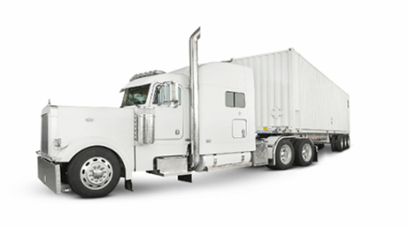
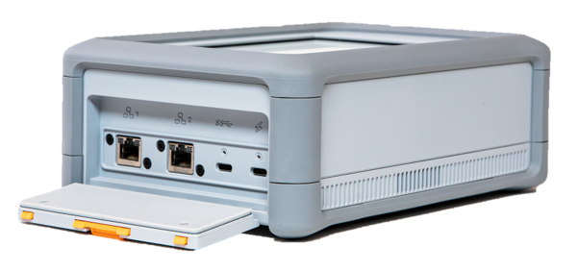
AWS Snow Family
AWS SNOWCONE | AWS SNOWBALL | AWS SNOWMOBILE
Notes:
m9-06 = “AWS Snow Family Overview”
We touched on the SNOW family of products in the Storage section of this course, but I want to mention them here again because they ARE also used in migrations and transfers.
These are actual physical storage devices that hold massive amounts of data, and they can shipped (or driven) to you and then shipped back to Amazon to physically plug in and transfer your data.
And the way I remember them is to compare them to the size of the “snow” things they’re named after. (click) A snowcone is the smallest, then the snowball (click) (though this is a pretty large snowball that the girl has in this picture) and then the (click) snowmobile is the largest of the group—and on the Amazon side is ACTUALLY a semi-truck that they send to your location to get your data.
If you go out to Amazon’s site: https://aws.amazon.com/snow/ , you’ll see a feature comparison across the products, as well as the main usage scenario for them. Now, for the exam, you’re not going to be tested on all the details here. But if you get a question about needing to transfer massive amounts of data in a secure way, or it references physical storage devices, you want to think about the Snow family here.

Slide 19
Important Points to Remember
DATABASE MIGRATION SERVICE (DMS)
Used to migrate databases from on-premises to AWS, AWS to AWS, or AWS to on-premises
Supports homogeneous (same database engines) or heterogeneous (different database engines)
For heterogeneous, use the Schema Conversion Tool
DATASYNC
Used to transfer large amounts of data from on-premises to AWS, AWS to AWS, or other cloud providers to AWS
DataSync agent installed at the source
On a schedule, data is transferred to DataSync in AWS, and then copied to the AWS destination service (S3, EFS, FSx)
Notes:
m9-07 = “Important Points to Remember”
This was a relatively short module, but let’s still take a minute to summarize the important points.

Slide 20
Important Points to Remember
APPLICATION MIGRATION SERVICE
Used for lift-and-shift migrations from on-premises to AWS
Replaces the Server Migration Service (SMS)
AWS TRANSFER FAMILY
Used to transfer files over FTP to either S3 or EFS
AWS SNOW FAMILY
Physical devices used to transfer data from on-premises to AWS
Snowcone, Snowball, Snowmobile (a semi-truck)

